Slide 1
Long-term vegetation progression simulation
Floris Leysen
Notes:
Good morning.
Thanks for joining.
What does it mean?

Slide 2
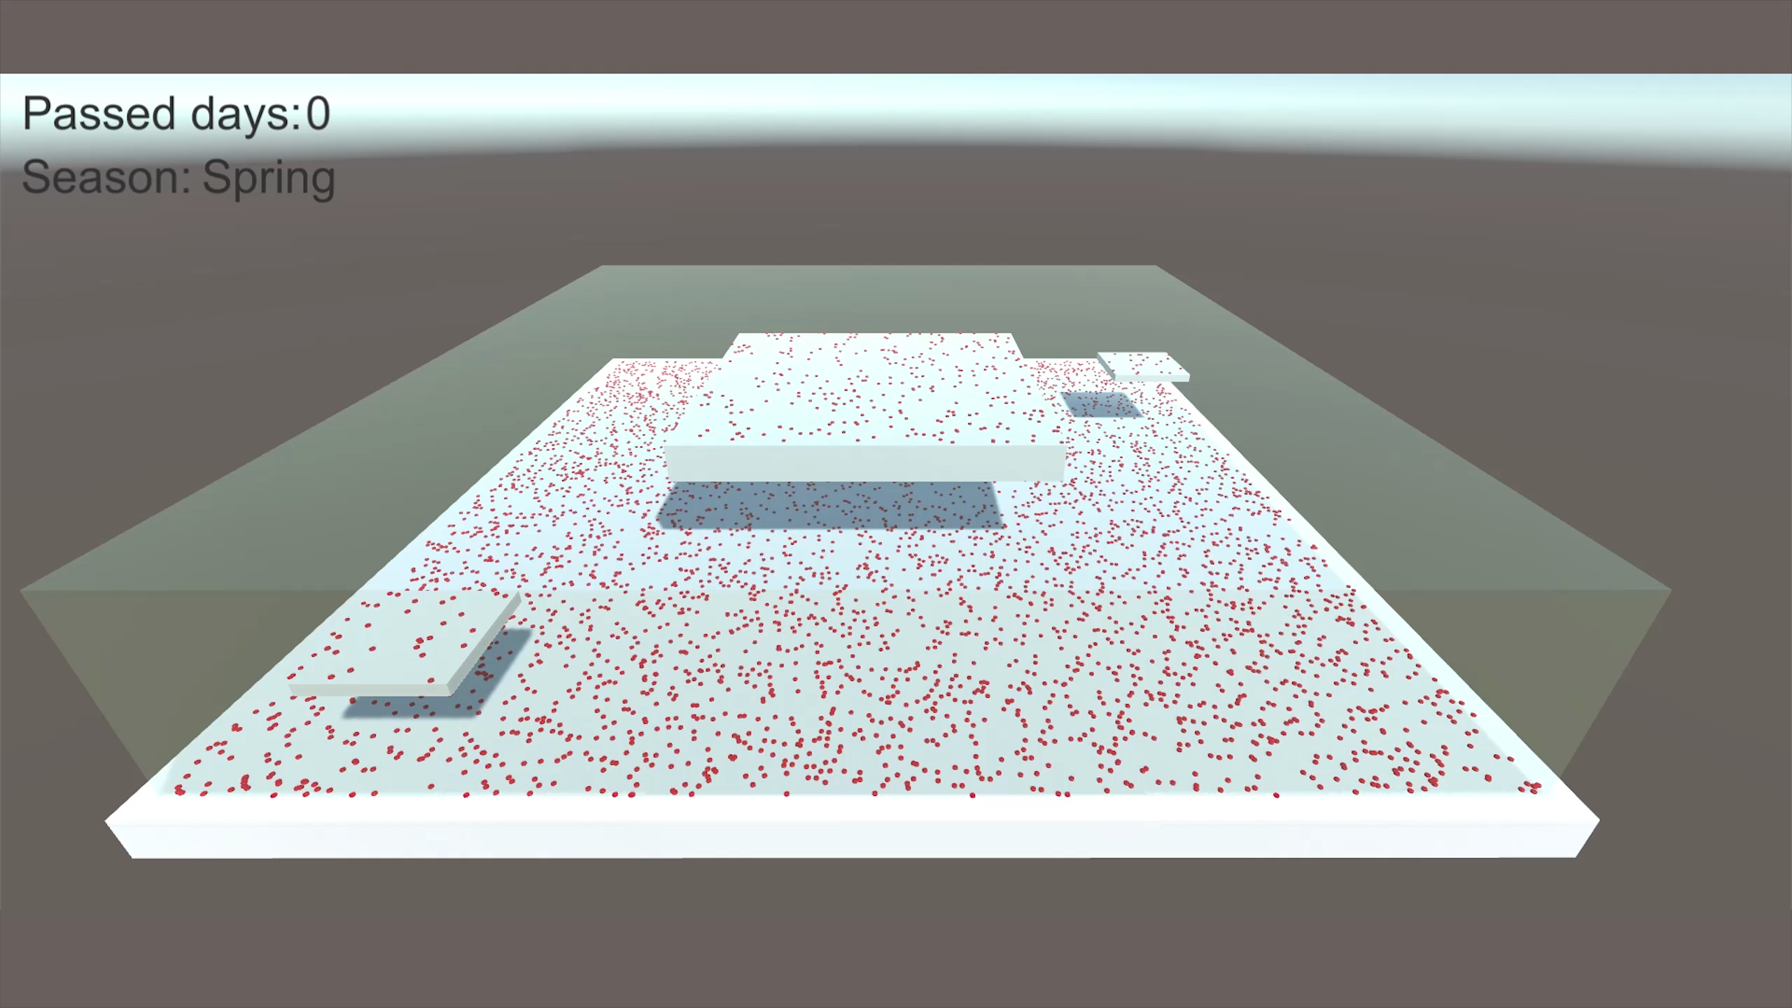

Slide 3
What and why?
Unity framework
Predefined environment
Plants determine own rules
Allows passing of time
Unexplored niche

Slide 4
Training Outline
Lesson 1: Name
Provide brief description, if desired.
Lesson 2: Name
Provide brief description, if desired.
Lesson 3: Name
Provide brief description, if desired.
Notes:
Lesson descriptions should be brief.

Slide 5
Lesson 1: Objectives
List the intended outcomes for this training session.
Each objective should be concise, should contain a verb, and should have a measurable result.
Tip: Click and scroll in the notes pane below to see examples, or to add your own speaker notes.
Notes:
Example objectives
At the end of this lesson, you will be able to:
Save files to the team Web server.
Move files to different locations on the team Web server.
Share files on the team Web server.

Slide 6
Lesson 1: Content
Add text here.
To add a picture, chart, or other content in the right column, click the appropriate icon.
To add a slide, click New Slide on the Insert menu, or press CTRL+M.

Slide 7
Lesson 1: Wrap-up
Summarize important points.
Allow time for questions.

Slide 8
Lesson 2: Objectives
List the intended outcomes for this training session.
Each objective should be concise, should contain a verb, and should have a measurable result.

Slide 9
Lesson 2: Content
Add text here.
To add a picture, chart, or other content in the right column, click the appropriate icon.
To add a slide, click New Slide on the Insert menu, or press CTRL+M.

Slide 10
Lesson 2: Wrap-up
Summarize important points.
Allow time for questions.

Slide 11
Lesson 3: Objectives
List the intended outcomes for this training session.
Each objective should be concise, should contain a verb, and should have a measurable result.

Slide 12
Lesson 3: Content
Add text here.
To add a picture, chart, or other content in the right column, click the appropriate icon.
To add a slide, click New Slide on the Insert menu, or press CTRL+M.

Slide 13
Lesson 3: Wrap-up
Summarize important points.
Allow time for questions.

Slide 14
Summary of Training
List important points from each lesson.
Provide resources for more information on subject.
List resources on this slide.
Provide handouts with additional resource material.

Slide 15
Assessment and Evaluation
Prepare a quiz or challenge to assess how much information participants learned.
Survey participants to see if they found the training beneficial.

